Slide 1
First Steps in Modularisation and General Algorithms for Common Business Problems
Session 04
(Lecture)
Course : Program Design Methods
Effective Period : July 2018

Slide 2
These slides have been adapted from
Simple Program Design : A Step by step approach., Lesley Anne Robertson, Fifth Edition,
Course Technology. ISBN: 978-1-4239-0132-7. Chapter 7 - 8
Acknowledgement

Slide 3
LO 3 : Design the application using program design method
LO 4 : Demonstrate the use of program design method
Learning Objectives

Slide 4
Contents
Modularisation
Hierarchy Charts or structure charts
Steps in modularisation
Programming examples using modules
Program Structure
Report generation with page break
Single – level control break
Program Structure
Report Generation with page break
Single - Level control break
Multiple level control break
Sequential file update

Slide 5
Array Processing

Slide 6
Array Processing
An array is a data structure that is made up of a number of variables all of which have the same data type.
The individual data items that make up the array are referred to as the elements of the array. Elements in the array are distinguished from one another by the use of an index or subscript, enclosed in parentheses, following the array name.
Example :
scores (6)
scores (index)

Slide 7
Operations on Arrays
The most typical operations performed on arrays are
  Loading a set of initial values into the elements of an array
  Processing the elements of an array
  Searching an array, using a linear or binary search, for a particular element
  Writing the content of an array to a report

Slide 8
Example
Example: each element of the array is accumulated into a variable called sum. When all elements have been added, the variable sum is printed
Find_sum_of_elements
set sum to zero
DO index=1 to number_of_elements
sum = sum + array(index)
ENDDO
print sum
END

Slide 9
Initializing the Elements of an Array

Slide 10
Initialising the elements of an array
Because an array is an internal data structure, initial values must be placed into the array before any information can be retrieved from it.
These initial values can be assigned to the elements of the array as constants, or they can be read into the array from a file

Slide 11
Loading constant values into an array
This method should only be used when the data in the array is unlikely to be changes
Example
initialise_month_table
month_table(1) = ‘January ’
month_table(2) = ‘February ’
..
..
month_table(12) = ‘December ’
END
Note that each element of the array must be the size of the largest element – in this case September – so, the shorter month names must be padded with blanks (spaces)

Slide 12
Arrays of variable size
In some programs, the number of entries in an array can vary. The algorithm for loading values into an array of variable size must include a check to ensure that no attempt is made to load more entries into the array than there are elements

Slide 13
Paired arrays
Many arrays in business application are paired; that is, there are two arrays that have the same number of elements.
The arrays are paired because the elements in the first array correspond to the elements in the same position in the second array
For example:
product_codes(index)=input product_code
selling_prices(index)=input selling_price

Slide 14
Searching an Array

Slide 15
Searching an array
The reasons for searching an array may be :
  To edit and input value – that is , to check that it is a valid element of an array
  To retrieve information from an array
  To retrieve information from a corresponding element in a paired array
There are two ways for searching an array
  Linear search
  Binary search

Slide 16
Array searching techniques
A linear search of an array
  Involves looking at each of the elements of the array, one by one ,starting with the first element.
A binary search of an array
  locates the middle element of array first, and determines if the element being searched for is in the first or second half of the table.
  The search then points to the middle element of the relevant half table and the comparison is repeated.
  This technique of continually halving the number of elements under consideration is continued until the data item being searched for is found or its absence is detected

Slide 17
Writing out the Contents of an Array

Slide 18
Writing out the contents of an array
Writing out the contents of an array involves starting with the first element of the array and continuing until all elements have been written. This can be represented by a simple DO loop
Example
write_values_of_array
DO index = 1 to number_of_elements
print array(index)
ENDDO
END

Slide 19
Two Dimensional Array

Slide 20
Two dimensional array
An element of a two-dimensional array is specified using the name of the array, followed by two subscript, enclosed in parentheses and separated by a comma
Example
freight_charges(1,1)
freight_charges(row_index,column_index)
A two-dimensional array is loaded in columns within row order; all the columns for row one are loaded before moving to row two and loading the column for that row, and so on

Slide 21
Writing out the contents of two dimensional array
To write out the contents of a two-dimensional array, write out the elements in the column within a row, before moving on to the next row.
Example :
write_value_of_array
set number_of_rows to required value
set number_of_columns to required value
DO row_index = 1 to number_of_columns
DO column_index=1 to number_of_columns
print array(row_index,column_index)
ENDDO
ENDDO
END

Slide 22
Modularisation

Slide 23
Modularisation
Modularisation is the process of dividing a problem into separate tasks, each with a single purpose.
Top down design methodology allows you to concentrate on the overall design of the algorithm before getting involved with the details of the lower-level modules

Slide 24
Benefits of modular design
Benefit of modular design
  Ease of understanding : each module should perform just one function
  Reusable code : modules used in one program can also be used in other programs
  Elimination of redundancy : using modules can help to avoid the repetition of writing out the same segment of code more than once
  Efficiency of maintenance : each module should be self-contained and have little or no other modules within the program

Slide 25
Hierarchy Chart or Structure Chart

Slide 26
Hierarchy chart or structure chart
Once the tasks have been grouped into functions or modules, these modules can be represented graphically in a diagram. This diagram is known as hierarchy chart
A hierarchy chart uses a tree-like diagram of boxes, each box represents a module in the program and the lines connecting the boxes represent the relationship of the modules to others in the program hierarchy.
At the top of the hierarchy chart is the controlling module or mainline.

Slide 27
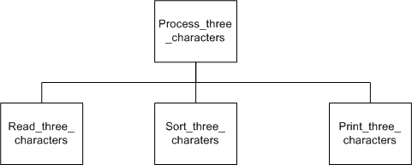
Hierarchy Chart
Example

Slide 28
Steps in Modularisation

Slide 29
Steps in modularisation
There are six steps in modularisation
  Define the problem
  Group the activities into modules
  Construct a hierarchy chart
  Establish the logic of the mainline of the algorithm, using pseudocode
  Develop the pseudocode for each successive module in the hierarchy chart
  Desk check the solution algorithm

Slide 30
Most common modules
The three most common modules are
  An initial processing module, containing the steps to be performed at the beginning of the algorithm before the loop begins
  A processing module inside the loop containing all the steps necessary to process one record or piece of data
  A final processing module, containing the steps to be performed at the end of the algorithm, outside the loop

Slide 31
Programming Example

Slide 32
Example
The Domestic Gas Supply Company records its customers’ gas usage figures on a customer usage file. Each record on the file contains the customer’s number, name, address, and gas usage expressed in cubic metres. Design a solution algorithm that will read the customer usage file, calculate the amount owing for gas usage for each customer, and then print a report listing each customer’s number, name, address, gas usage and the amount owing
The company bills its customers according to the following rate : if the customer’s usage is 60 cubic metres or less, a rate of $2.00 per cubic metre is applied; if the customer’s usage is more than 60 cubic metres, than a rate of $1.75 per cubic metre is applied for the first 60 cubic metres and $1.50 per cubic metre for the remaining usage
At the end of the report, print the total number of customers and the total amount owing to the company

Slide 33
Example
Define the problem
B. Group the activities into modules
Four modules will be used in the solution algorithm:
A module to perform some initial processing before loop
A module to calculate the amount owing for each customer
A module to print the customer details
A module to print the totals after exiting the loop
Input | Process | Output
customer usage records customer_number name address gas_usage | Print heading Read usage records Calculate amount owing Print customer details Compute total customers Compute total amount owing Print totals | Heading line Customer details customer_number name address gas_usage amount_owing total_customers total_amount_owing

Slide 34
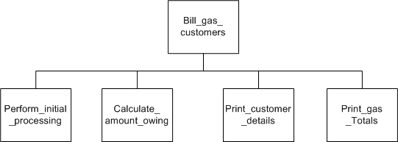
Example
C. Construct a hierarchy chart

Slide 35
Example
D. Establish the logic of the mainline of the algorithm, using pseudocode
Bill_gas_customers
1 Perform_initial_processing
2 read customer record
3 DOWHILE more records
4 calculate_amount_owing
5 print_customer_details
6 read customer record
ENDDO
7 print_gas_totals
END

Slide 36
Example
E. Develop the pseudocode for each successive module in the hierarchy chart
Perform_initial_processing
8 print ‘CUSTOMER USAGE FIGURES’ heading
9 set total_Customer to zero
10 set total_amount_owing to zero
END
Calculate_amount_owing
11 IF usage <= 60 THEN
amount_owing = usage * $2.00
ELSE
amount_owing=(60*1.75)+((usage - 60)*$1.50)
ENDIF
12 add amount_owing to total_amount_owing
END

Slide 37
Example
E. Develop the pseudocode for each successive module in the hierarchy chart
Print_customer_details
13 print customer_number, name, address, gas_usage, amount_owing
14 add 1 to total_customers
END
Print_gas_totals
15 print total_customers
16 print total_amount_owing
END

Slide 38
Example
F. Desk Check the solution algorithm
The desk checking of an algorithm with modules is not different from the method developed for previous examples
  Create some valid input test data
  List the output that the input data is expected to produce
  Use a desk check table to walk the data through the mainline of the algorithm to ensure that the expected output is achieved. When a sub module is called, walk the data through each line of that module as well and then return to the calling module

Slide 39
Example
F. Desk Check the solution algorithm
Input data
three test cases will be used to test the algorithm
Customer record | Gas_usage(cubic metres)
customer 1 | 40
customer2 | 61
customer3 | 80
EOF

Slide 40
Example
F. Desk Check the solution algorithm
2. Expected results

Slide 41
Example
F. Desk Checking the solution algorithm
3. Desk check table

Slide 42
Program Structure

Slide 43
Program Structure
The general solution algorithm consisted of a mainline module and three subordinate modules. These are :
  An initial processing module, containing the steps to be performed at the beginning of the algorithm, before the loop begins
  A processing module inside the loop containing all steps necessary to process one record or piece of data
  A final processing module, containing the steps to be performed at the end of the algorithm, outside the loop

Slide 44
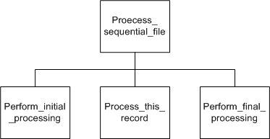
Hierarchy Chart
The hierarchy chart looked like this

Slide 45
Report Generation with Page Break

Slide 46
Report generation with page break
Most reports require page heading lines, column heading lines, detail lines and total lines. Reports are also required to skip to a new page after pre-determined number of detail lines have been printed

Slide 47
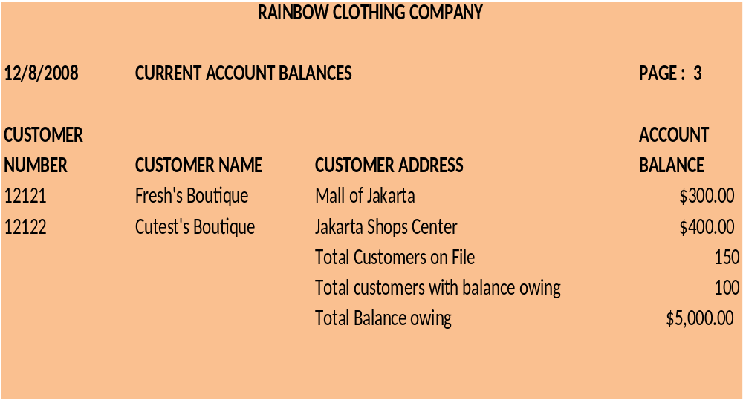
Example
A typical report might look like this :

Slide 48
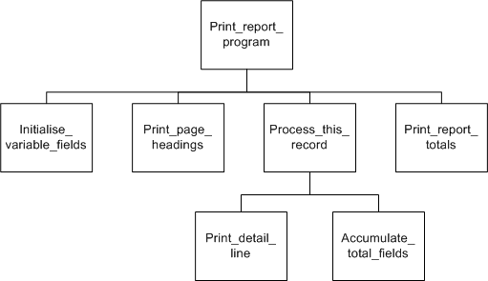
Report generation with page break
Hierarchy Chart
  The general solution algorithm for processing a sequential file can be extended by the addition of three new modules to cater for these report requirements these new modules are Print_page_heading, Print_detail_line, and Accumulate_total_fields

Slide 49
Single Level Control Break

Slide 50
Single level control break
A control break total line is a summary line for a group of records that contain the same record key. this record key is referred as the control field.
This control field is used to identify a record or a group of records within a file. A control break occurs each time there is a change in value of the control field. Thus, control break total lines are printed each time a control break is detected

Slide 51
Single level control break
The sample of single level control break

Slide 52
Single level control break
Two things that need to be considered when designing a control break program
  The file to be processed must have been sorted into control field sequence. If the file has not been sorted, erroneous results will be occur
  Each time a record is read from the input file, the control field on the current record must be compared with the control field on the previous record. If the control fields are different, a control break total line must be printed for the previous set or records, before the current records is processed

Slide 53
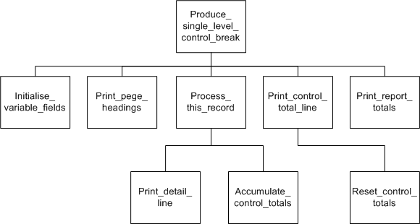
Single level control break
Hierarchy Chart

Slide 54
Single level control break
All control break report program will require the following variables:
A variable named this_control_field, which will hold the control field of the record just read
A variable named prev_control_field, which will hold the control field of the previous record
One or more variables to accumulate the control break totals
One or more variables to accumulate the report totals

Slide 55
Multiple Level Control Break

Slide 56
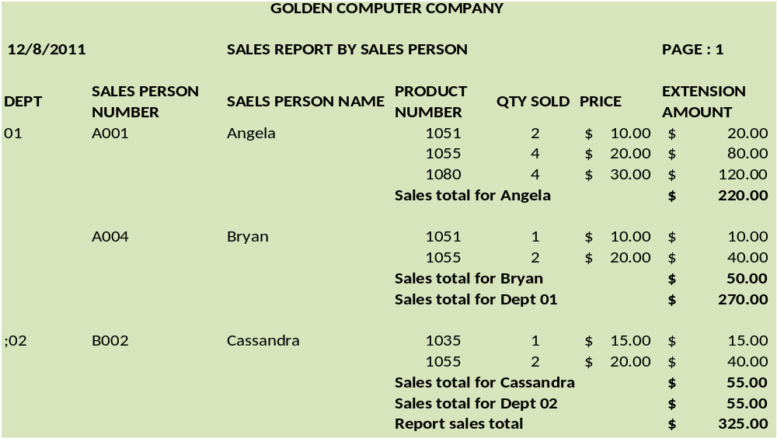
Multiple level control break
The multiple level control break might look like this

Slide 57
Multiple level control break
The concept that applied to a single level control break program also apply to multiple-level-control-break program
  The input file must be sorted into control field sequence. When there is more than one control field, the file must be sorted into a sequence of minor control field within major control field
  Each time a record is read from the file, the control field (minor and major) on the current record must be compared with the control field of the previous record.

Slide 58
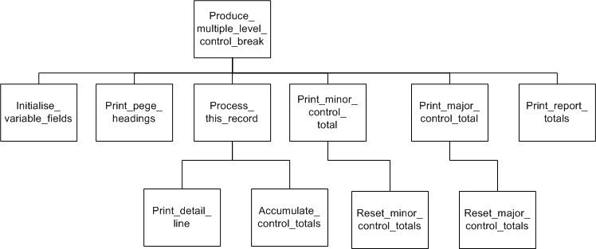
Hierarchy chart

Slide 59
Sequential File Update

Slide 60
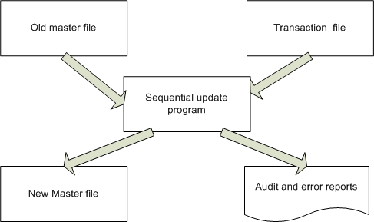
Sequential file update
Sequential file update involve updating a master file by applying update transaction to a transaction file. Both the master file and the transaction are sequential. A new file master file that incorporates the updated transaction is produced. Usually, audit reports and error reports are also printed

Slide 61
System concepts
System concepts
  Master file : is a file that contains permanent and semi permanent information about the data entities it contains
  Transaction file : contains all the data and activities that are included on the master file . There are usually three types of update transaction on this file.
    Add a new record
    Update or change an existing record
    Delete and existing record
  Audit report : is a detailed list of all transactions that were applied to the master file
  Error report : is a detailed list of errors that occurred during the processing of the update

Slide 62
References
Simple Program Design : A Step by step approach., Lesley Anne Robertson, Fifth Edition,
Course Technology. ISBN: 978-1-4239-0132-7.
Working with files, http://www.thevbprogrammer.com/Ch06/06-01-SeqFiles1.htm
Functions, http://aelinik.free.fr/c/ch15.htm

Slide 63
References
Simple Program Design : A Step by step approach., Lesley Anne Robertson, Fifth Edition,
Course Technology. ISBN: 978-1-4239-0132-7.
General Arrays, http://www.thevbprogrammer.com/Ch07/07-01-Arrays1.htm
Storing similar data items, http://aelinik.free.fr/c/ch12.htm
Scope and Storage, http://aelinik.free.fr/c/ch14.htm
Working with files, http://www.thevbprogrammer.com/Ch06/06-01-SeqFiles1.htm
Functions, http://aelinik.free.fr/c/ch15.htm

Slide 64
Q & A

